Slide 1

Network Switching Security
By: Cody Murrer

Slide 2
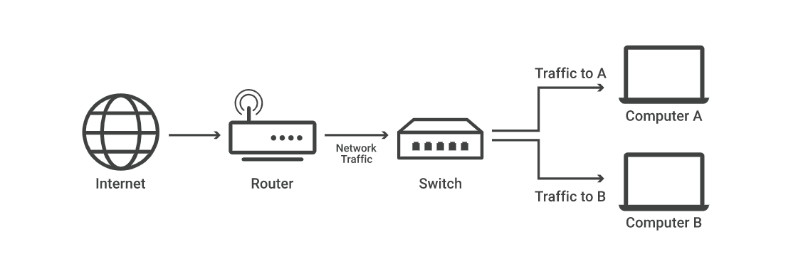
What are network switches
A network switch connects devices within a network usually using LANs to forward data packets to and from those devices.
A switch only sends data to a single device it is intended for which could be another switch, a router, or a computer.

Slide 3
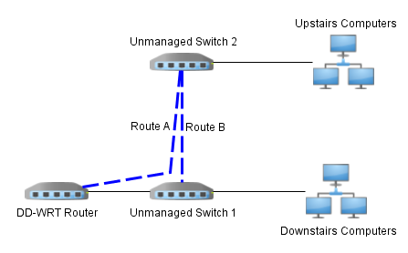
Different types of network switches
Managed switches
Give you greater security and more features/flexibility because you can configure them to custom-fit a network giving greater control and better protection to your network.
Unmanaged switches
Designed to be plug and play. There is no configuring required and typically used for basic connectivity. They are often used in home networks or wherever a few more ethernet ports are needed such as an office or a lab.

Slide 4
How network switches work
Switches are key implementations within a network they connect multiple devices in the network together.
They are usually found within the second layer (link layer)
Switches can determine how to send specific data to specific devices by using MAC addresses.
Switches within the network are linked to devices using ethernet cables.
Switches also use packet segmentation in order to reduce collisions.

Slide 5
Attacks on switches
There are many different types of attacks within network switches since their security measures differ between the different switches (unmanaged and managed).
The different attacks that take place on network switches on a regular basis are.
ARP Spoofing
MAC Flooding
DHCP Server Spoofing
MAC Spoofing
VLAN Spoofing

Slide 6
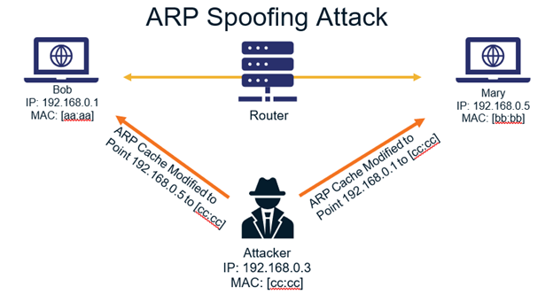
ARP Spoofing
With ARP spoofing the attacker sniffs and listens for ARP requests and answers them.
They answer the requests by giving its IP address as the default gateway to the client.
This makes the attacker a man in the middle.

Slide 7
ARP Spoofing Prevention
Small simple solution to prevent ARP Spoofing.
Enable Dynamic ARP Inspection(DAI)
This is a security feature that verifies ARP requests and responses in a network.

Slide 8
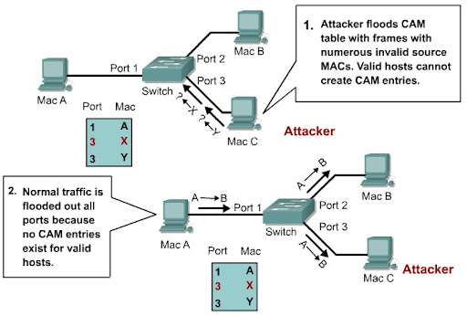
MAC Flooding
The attacker floods the Content Addressable Memory(CAM) table with MAC addresses more than the switch can store.
This leads to the switch to begin operating as a hub.
This gives the attacker the opportunity to sniff all traffic on the segment.

Slide 9
MAC Flooding Prevention
Method One: Configure network switch port security.
This involves limiting the number of MACs allowed through the port and can also specify what are the allowed MACs.
Method Two: Port Based Authentication.
Requires PC to be authenticated before joining the LAN. This can be combined with port security to allow only authenticated PCs with a specific MAC to join the LAN.

Slide 10
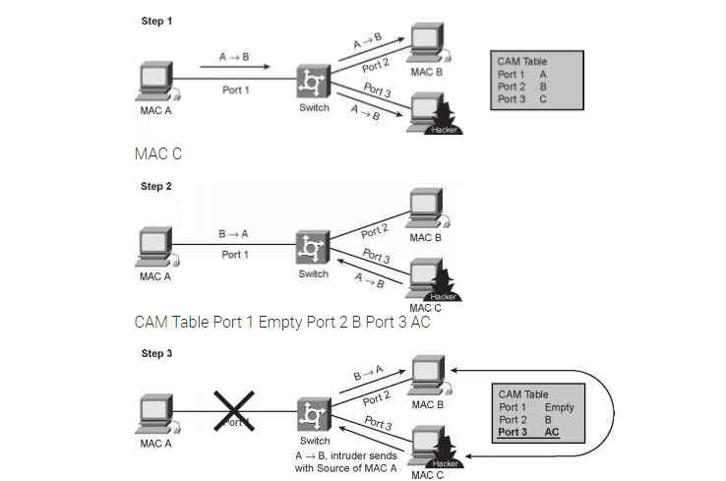
MAC Spoofing
MAC Spoofing can circumvent the methods used to prevent flooding.
The attacker sniffs the network for valid MAC Addresses and attempts to act as one of the trusted addresses.
The attacker presents itself as the default gateway and copies all the data forwarded to the default gateway without being detected.

Slide 11
MAC Spoofing Prevention
There are a few ways to prevent MAC Spoofing
Enable port security however manually adding MAC addresses on every port is too great of a task.
Another solution is to use private VLANS to help mitigate these types of network attacks because it restricts communications between systems on the same IP subnet.

Slide 12
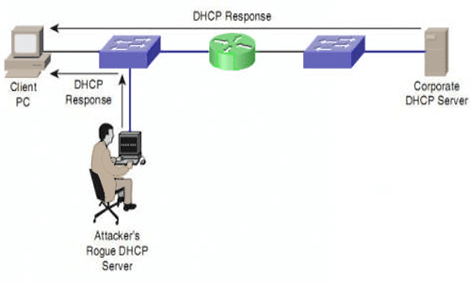
DHCP Server Spoofing
With DHCP snooping the attacker sniffs the network and listens for DHCP requests and answers them.
They answer the requests by giving its IP address as the default gateway to the client.
This makes the attacker a man in the middle.

Slide 13
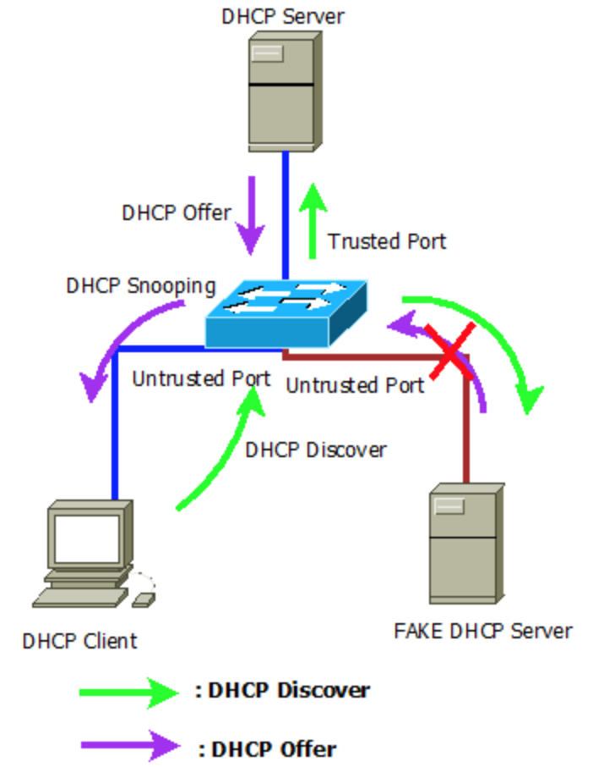
DHCP Spoofing Prevention
Configure DHCP snooping
Trust a specified port for all DHCP replies.
If DHCP reply message was received on any port other than the trusted one the new port will shut down.

Slide 14
VLAN Hopping
This type of attack is when a station is able to access VLAN other than its own which can be done through two different ways.
Switch Spoofing: A pc will claim to establish a trunk link between itself and the switch and gain all the VLAN information.
802.1q Double Tagging: The attacker double tags the frame with the native VLAN on its trunk list and the second tag is for the destined victim VLAN.

Slide 15
VLAN Hopping Prevention
Solution for Switch Spoofing
Disable the DTP messages on trunk ports and avoid the switch defaults regarding trunk links and hardcode the ports.
Configure all the ports that should connect to the end stations as access and assign them to an unused VLAN and shut them down.
Solution to 802.1q Double Tagging
Use the same solutions of the switch spoofing.
Configure VACL (VLAN Access Control List)
Private VLAN allow the division of VLANs into secondary VLANs making port isolation possible.

Slide 16

Implementations
MAC Spoofing
ARP Spoofing
DNS Spoofing

Slide 17
Sources
https://www.cisco.com/c/dam/en_us/training-events/le31/le46/cln/promo/share_the_wealth_contest/finalists/Hany_EL_Mokadem_Switch_Attacks_and_Countermeasures.pdf
https://digitalfortresslk.wordpress.com/2018/03/22/common-attack-types-on-switches/
https://www.cloudflare.com/learning/network-layer/what-is-a-network-switch/
https://www.cisco.com/c/en/us/solutions/small-business/resource-center/networking/network-switch-how.html

